Slide 1
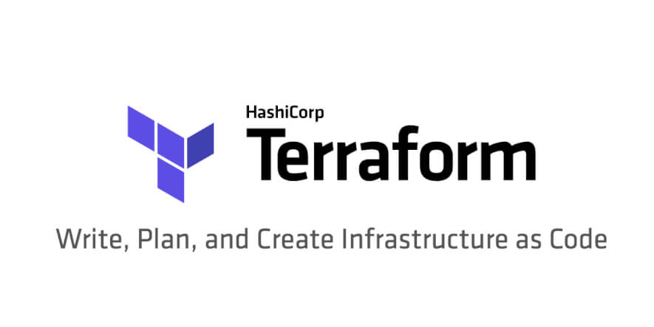
By Zouhair OUHDID

Slide 2
C’est Quoi ?
Terraform est un outil de gestion/management/provisioning des infrastructures as Code.
Utilisable sur de nombreux providers (GCP, AWS, Azure, Vmware …)
https://registry.terraform.io/browse/providers

Slide 3
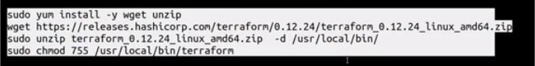
Installation
Lien de téléchargment : https://www.terraform.io/downloads.html

Slide 4
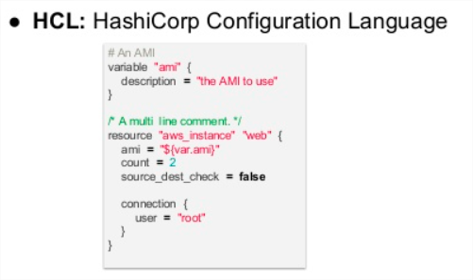
Configuration
Configuration files is written with HCL language built by HashiCorp.

Slide 5
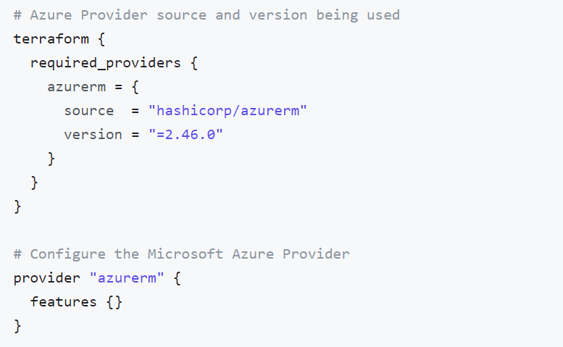
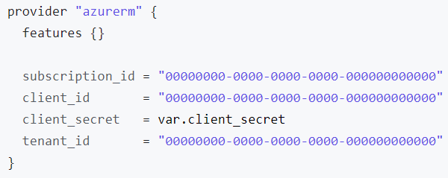
Provider
La première étape consiste à indiquer le nom du provisionning provider et spécifier les informations d’authentification
https://registry.terraform.io/providers/hashicorp/azurerm/latest/docs

Slide 6
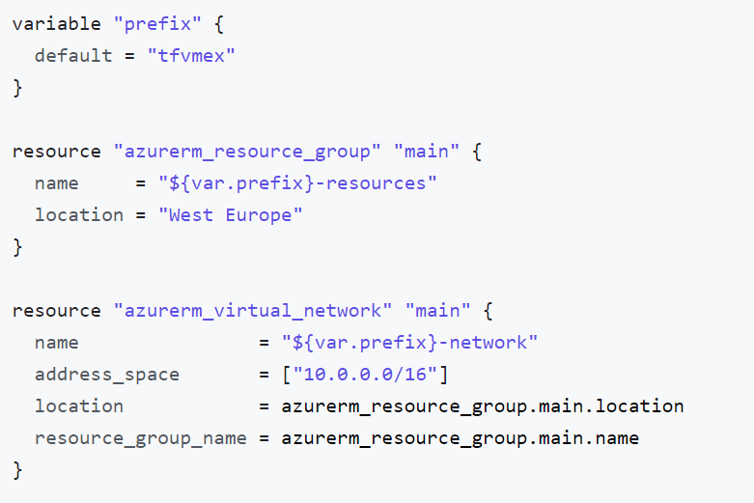
Defining Ressources

Slide 7
Terraform Commands
Terraform init (download provider plugins into .terraform/plugins
Terraform Plan (show the changements to be done)
Terraform apply (create/update resources , add -target to specify a specific resource to update)
Terraform Destroy (delete resources, add -target to specify a specific resource to delete)

Slide 8
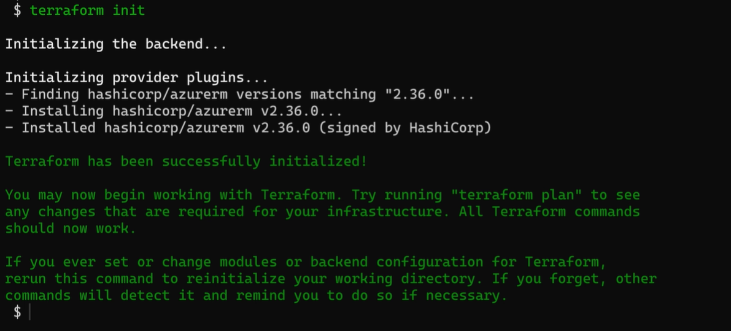
Terraform Commands

Slide 9
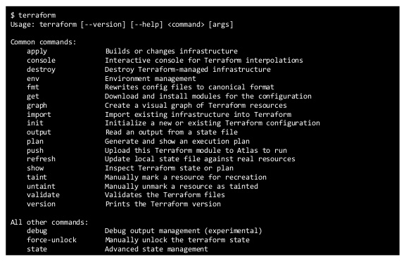
Terraform Commands

Slide 10
Variables
Input variables are usually defined by stating a name, type and a default value., However, the type and default values are not strictly necessary.
Terraform can deduct the type of the variable from the default or input value.
Variables can be predetermined in a file (variables.tf , terraform.tfvars) or included in the command-line options.
As such, the simplest variable is just a name while the type and value are selected based on the input.
variable "variable_name" {}
Export TF_VAR_variable_name="sometext"
terraform apply -var variable_name="value"
terraform apply –var-file file_with_vars.tfvar

Slide 11
Variables
Vars search by order:
Environnment Vars TF_VAR_
terraform.tfvars
*.auto.tvars
from -var and -var-file

Slide 12
Variables
variable "myvar" {
type = string
default = "some_text"
}
variable "zones" {
type = list(string)
default = [" A " , "B" , " C",]
}
variable "variable_name" {
type = map
default = {
size= " 10 "
type= " N1 "
}
}

Slide 13
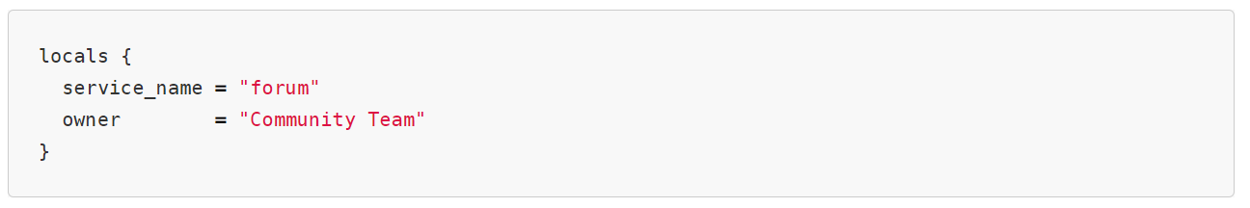
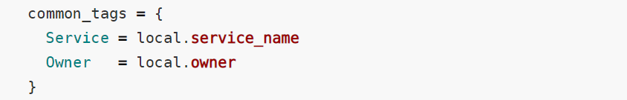
Locals (local variables)
A local value assigns a name to an expression, so you can use it multiple times within a module without repeating it.

Slide 14
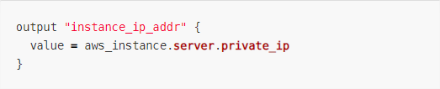
OUTPUT
Output values are like the return values of a Terraform module, and have several uses:
A child module can use outputs to expose a subset of its resource attributes to a parent module.
A root module can use outputs to print certain values in the CLI output after running terraform apply.

Slide 15
Interpolation
User string variables :
${var.username}
User map variables:
${var.instance["name"]}
User list variables:
${var.subnets}
${var.subnets[id]}
Attributes of resources:
${azurerm_windows_virtual_machine.vm.public_ip_address}

Slide 16
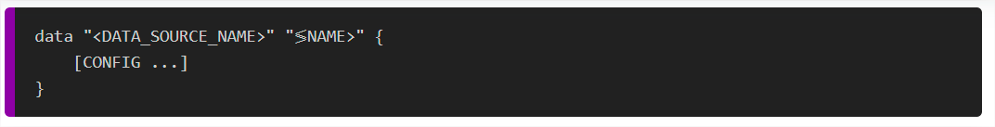
Data sources
Data sources allow data to be fetched or computed for use elsewhere in Terraform configuration. Use of data sources allows a Terraform configuration to make use of information defined outside of Terraform, or defined by another separate Terraform configuration.
DATA_SOURCE_NAME : correspond à la ressource sur laquelle vous souhaitez récupérer des informations
NAME : identifiant que vous pouvez utiliser dans le code Terraform pour faire référence à cette source de données.
CONFIG : un ou plusieurs arguments qui sont spécifiques à cette Data Source.

Slide 17
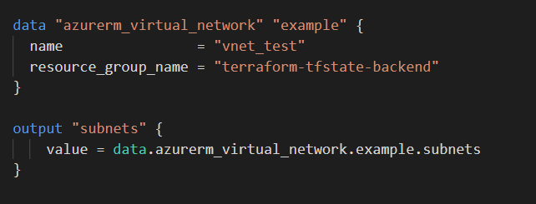
Data sources

Slide 18
Terraform state
Terraform stores state about your managed infrastructure and configuration.
This state is used by Terraform to map real world resources to your configuration, keep track of metadata, and to improve performance for large infrastructures.
This state is stored by default in a local file named "terraform.tfstate", but it can also be stored remotely, which works better in a team environment.

Slide 19
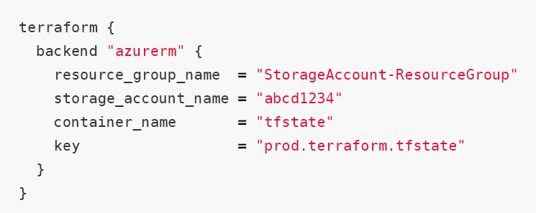
Stockage fichier State
Backends determine where state is stored. For example, the local (default) backend stores state in a local JSON file on disk.
When using a remote backend, In the case of an error persisting the state to the backend, Terraform will write the state locally. This is to prevent data loss. If this happens the end user must manually push the state to the remote backend once the error is resolved.
Backend.tf:

Slide 20
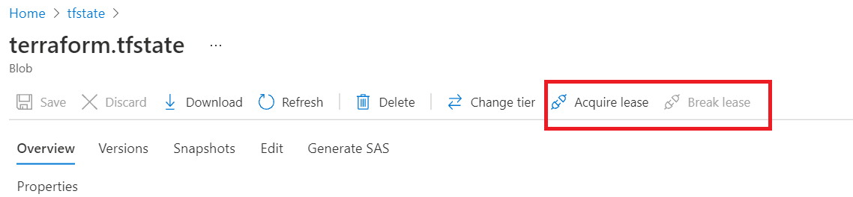
Tfstate Locking

Slide 21
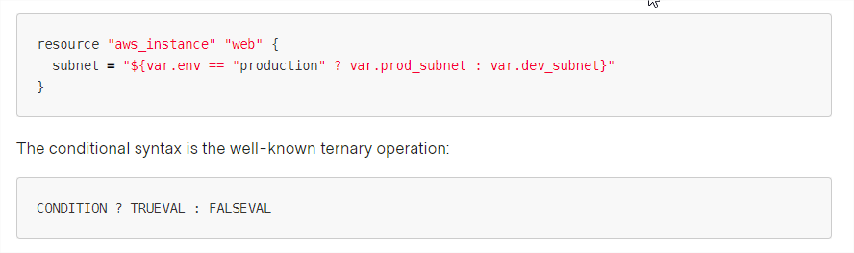
Conditions
The supported operators are:
Equality: == and !=
Numerical comparison: >, <, >=, <=
Boolean logic: &&, ||, Negation !

Slide 22

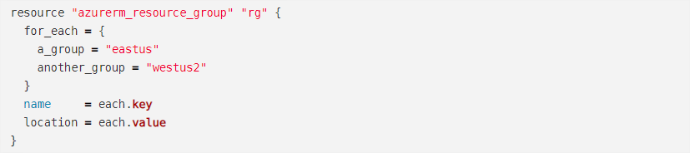

Boucles
count : loop over resources
for_each : loop over resources and inline blocks within a resource.
for : loop over lists and maps.

Slide 23
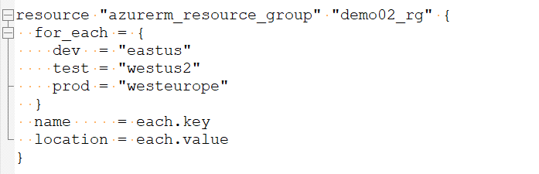
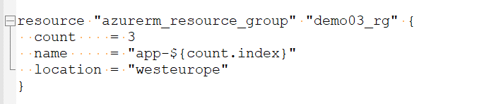
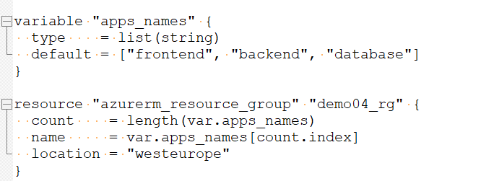
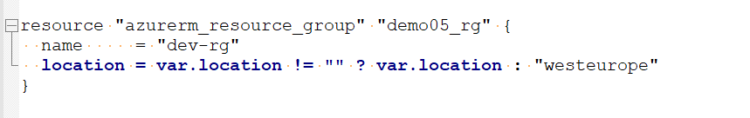
Examples

Slide 24
Functions
https://www.terraform.io/docs/language/functions/index.html
dirname(path) - Returns all but the last element of path, typically the path's directory.
concat(list1, list2, ...) - Combines two or more lists into a single list. Example: concat(aws_instance.db.*.tags.Name, aws_instance.web.*.tags.Name)
contains(list, element) - Returns true if a list contains the given element and returns false otherwise.
element(list, index) - Returns a single element from a list at the given index. If the index is greater than the number of elements
file(path) - Reads the contents of a file into the string. Variables in this file are not interpolated. The contents of the file are read as-is.
join(delim, list) - Joins the list with the delimiter for a resultant string. This function works only on flat lists.
length(list) - Returns the number of members in a given list or map, or the number of characters in a given string
split(delim, string) - Splits the string previously created by join back into a list. Example : ${length(split(",", "a,b,c"))} = 3
lookup(map, key, [default]) - Performs a dynamic lookup into a map variable.
max(float1, float2, ...) - Returns the largest of the floats.
substr(string, offset, length) - Extracts a substring from the input string.

Slide 25
PROVISIONER
Provisioners can be used to launch specific actions on the local machine or on a remote machine in order
to prepare servers or other infrastructure objects for service.
Local-exec
Remote-exec
File
resource “null_resource" “localsrv" {
provisioner "local-exec" {
command = "Get-Date > completed.txt"
interpreter = ["PowerShell", "-Command"]
environment = {
FOO = "bar"
BAR = 1
BAZ = "true"
}
}
}
resource “null_resource" “remotesrv" {
provisioner "remote-exec" {
inline = [
"chmod +x /tmp/script.sh",
"/tmp/script.sh args",
]
}
}
resource "aws_instance" "web" {
provisioner "file" {
source = "conf/myapp.conf"
destination = "/etc/myapp.conf"
}
provisioner "file" {
content = "ami used: ${self.ami}"
destination = "/tmp/file.log"
}
}
https://www.terraform.io/docs/provisioners/index.html

Slide 26
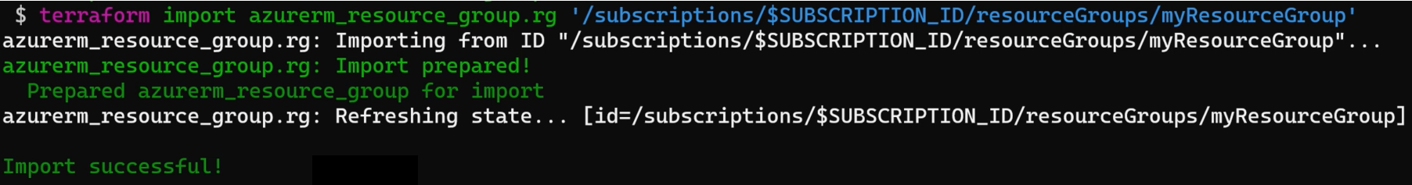
Terraform Import
Terraform is able to import existing infrastructure. This allows you take resources you've created by some other means and bring it under Terraform management.
The current implementation of Terraform import can only import resources into the state. It does not generate configuration. A future version of Terraform will also generate configuration.

